Slide 1
Defense of PhD Dissertation The semantics of Udmurt spatial cases
by Riku Erkkilä
Questions posed by Laura A. Janda,
UiT The Arctic University of Norway

Slide 2
Outline
Topic of dissertation and overall impressions
Questions
from Preliminary Examiner’s Statement
other specific questions about dissertation
questions to conclude discussion
Assessment of merits and critical points
Proposal concerning acceptance of dissertation

Slide 3
Topic of dissertation
semantic analysis of the spatial cases of Udmurt (inessive, elative, egressive, illative, terminative, prolative, and approximative)
theoretical perspective of Cognitive Linguistics and observed parallels between spatial cognition and language
analysis is informed by “principled polysemy” (adapted to facts of Udmurt) and typology of grammaticalization

Slide 4
Overall features of the dissertation
analysis draws on theoretical framework of Cognitive Linguistics, additionally also psychology and neurology
adaptation of theoretical models previously focused mainly on English to facts of Udmurt
documentation of facts of Udmurt
quantitative data on the distribution of senses within Udmurt spatial cases
illustrated with 380 authentic examples, all supplied with Leipzig glossing and translations

Slide 5
Overview of questions
Questions posed in Preliminary Examiner’s Statement
Other questions about the dissertation
Concluding questions about this line of research

Slide 6
Questions posed in Preliminary Examiner’s Statement

Slide 7
Where is possible rivalry in the system, both among spatial cases and with other cases?

Slide 8
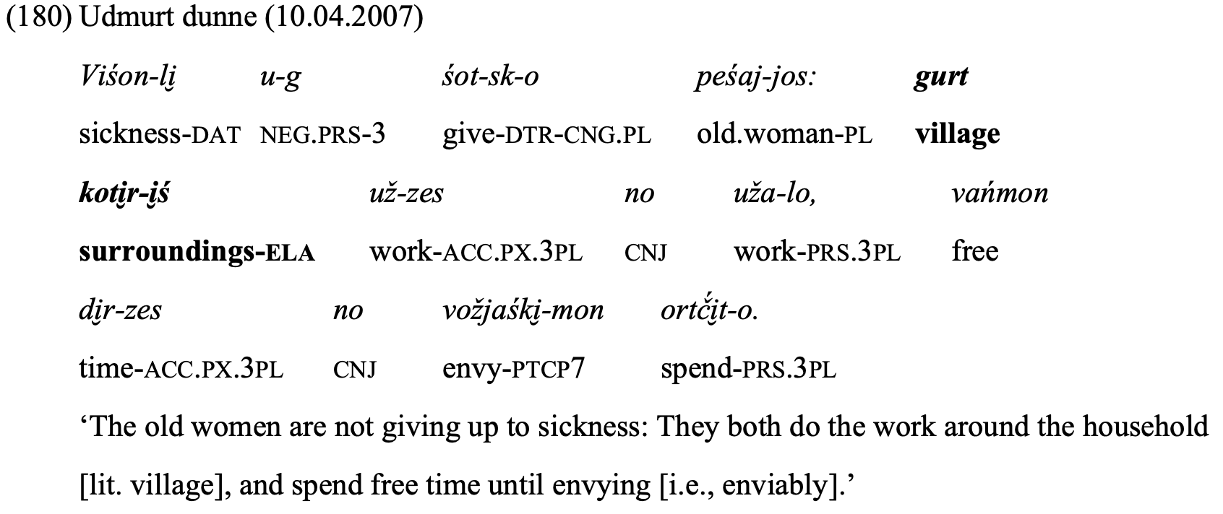
This example (p. 226) uses elative, but could inessive be used?

Slide 9
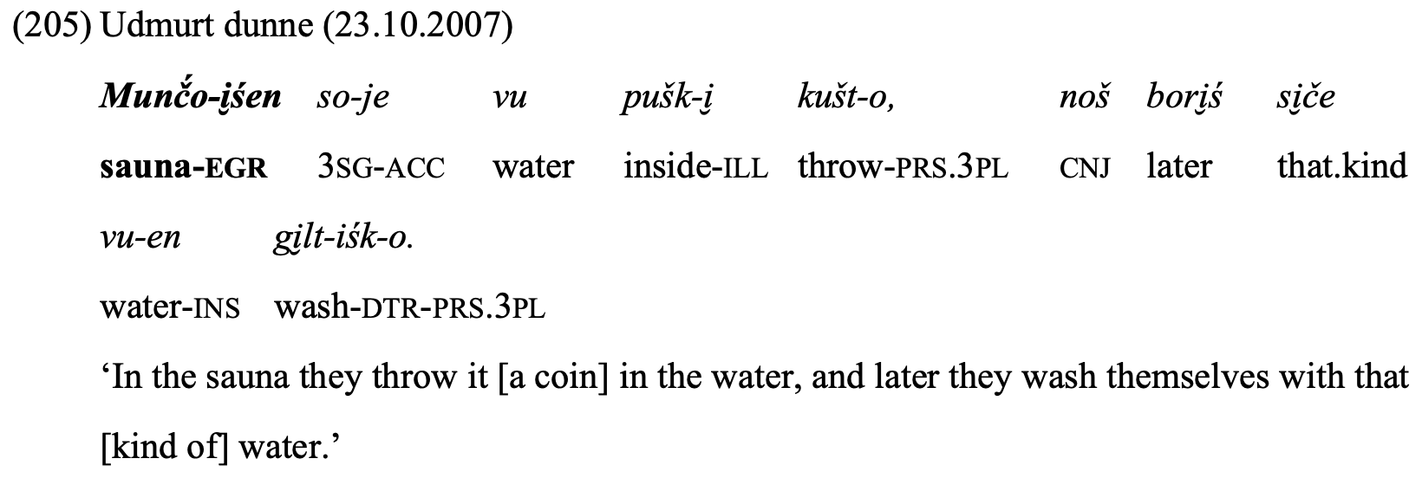
This example (p. 249) uses egressive, but could inessive be used?

Slide 10
What is the overall frequency (both ipm and relative) of the Udmurt spatial cases?
For example, is egressive more frequent than elative?
What is the relative frequency of source vs. goal cases?
Note that some have claimed that goal-orientation prevails in language

Slide 11
Why are some similar meanings/uses classified differently?
For the elative case there are five examples of uses that signal people from someplace (149, 152, 171, 175, 178), yet all of these have been annotated differently -- why?
(149) p. 204 “Origin” Ot-i̮ś eš-jos-i̮ni̮-m [there-ELA friend-PL-INS-PX.1SG] ‘my friends from there’
(152) p. 206 “Source” ni̮l.pi jurt-i̮ś [child house-ELA] ‘boy from orphanage’
(171) p. 219 “Location” Ač́-iz, pe, Baškiri-i̮ś, [self-3SG PCL PLN-ELA] ‘She is apparently from Bashkortostan’
(175) p. 223 “Place” pe̮rtem sereg-jos-i̮śt-i̮z eš-jos [different corner-PL-ELA-PX.3SG friend-PL] ‘friends from different corners’
(178) p. 225 ambiguous between “Place” and “Origin” ot-i̮ś ji̮bi̮rtjaś-jos-ti̮ [that-ELA bower-PL-ACC] ‘worshippers [from] there’

Slide 12
Why are idiomatic uses termed “periphery constructions”?
Does this term come from Schmid 2014?
Do idiomatic uses play any important role in the system, or should they be set aside?
p. 141 на солнце šundi̮ vi̮ l-i̮ n [sun top-INE]
pp. 279-80 под суд sud ul-e [trial under-ILL]
p. 210 uloni̮ ś koški̮ ni̮ ‘die [lit. leave from life]’
pp. 227-228 Nunal-i̮ ś nunal-e [day-ELA day-ILL] from day to day

Slide 13
Other questions about the dissertation

Slide 14
p. 64, p. 68
Table 2: There is a desinence of -∅ cited for the illative. What is your understanding of zero morphemes?
“only content nouns with inanimate referents can be inflected in spatial cases”
So how are spatial relations with animates expressed? By adpositions?

Slide 15
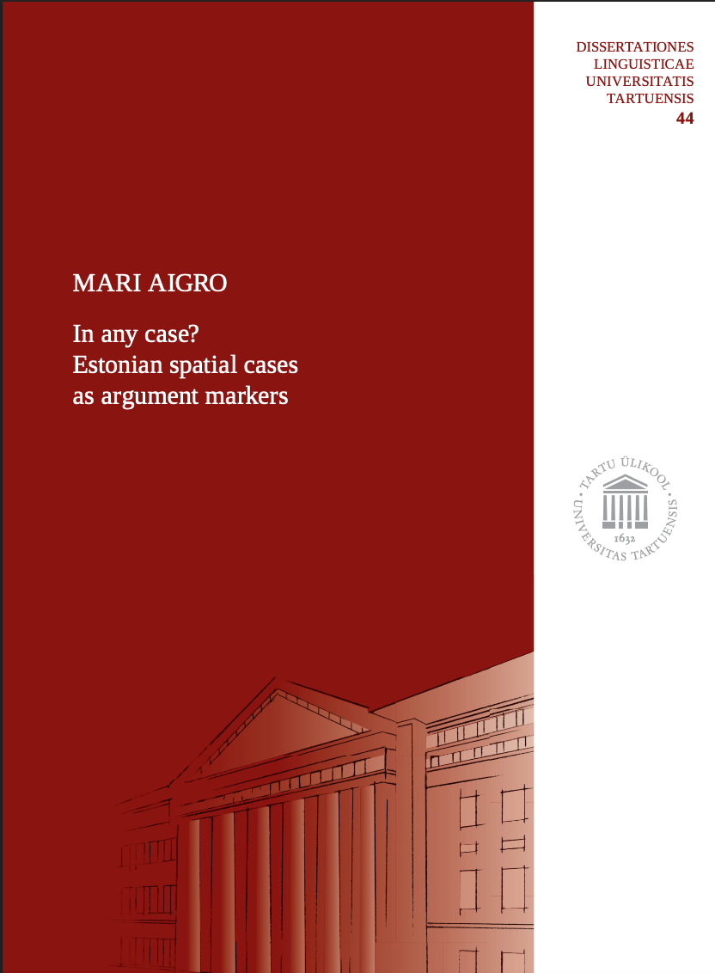
Aigro 2022 PhD dissertation
on Estonian spatial cases
14 cases in Estonian
3 are “structural” (aka “syntactic”, “grammatical”) cases mark core argument roles: nominative, partitive, genitive
11 are “semantic”, of these
6 are spatial cases: illative ‘into’, inessive ‘in’, elative ‘out of’, allative ‘onto’, adessive ‘on’, ablative ‘from on’
Spatial cases can sometimes be used to mark core argument roles (see next slide), and the structural cases sometimes appear in adverbials.

Slide 16
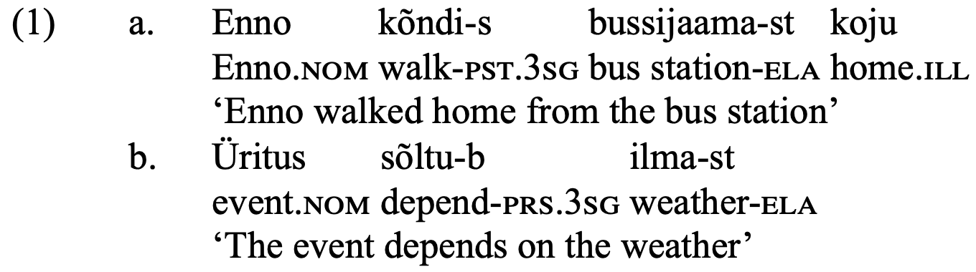
Aigro 2022 PhD dissertation on Estonian spatial cases
“semantic”
“structural”

Slide 17
Comparing Estonian and Udmurt spatial cases
Is there any “leakage” in Udmurt, are there uses of spatial cases to mark argument roles, or syntactic cases to mark adverbials?
If not, why would Udmurt be different from Estonian?
Aigro suggests that the use of spatial cases with human referents leads to the bleaching of spatial cases and grammaticalization to mark argument roles. What do you think of this?

Slide 18
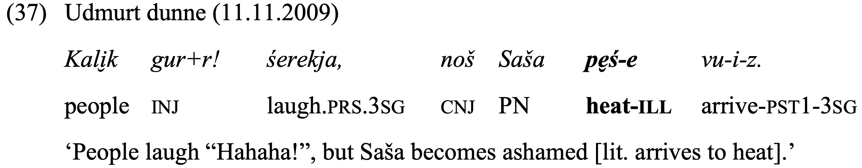
Talmyan classification, caused-motion, resultatives
Is Udmurt verb-framed or satellite-framed? How does this play out with respect to spatial cases?
Are there caused-motion or resultative uses? Is ex (37) on p. 106 an example of resultative?

Slide 19
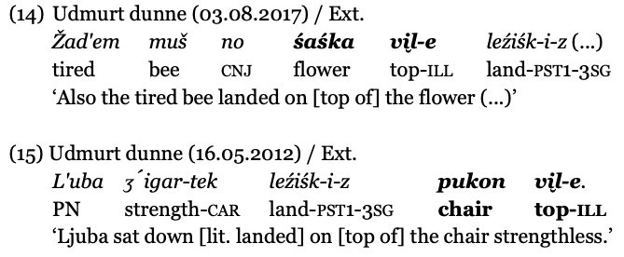
Relational nouns: vi̮l- ‘top’, dor- ‘near’-, pum- ‘end’, bord- ‘next, near’, ul- ‘under’
I get the sense that SURFACE vs. CONTAINER is disambiguated by relational noun vi̮l- ‘top’ – is that correct?
What is the LM (landmark)? Is it the noun modified by the relational noun or just the relational noun? cf. these exx. on p. 41:

Slide 20
Role of other factors in case semantics
Why should the meanings of verbs (e.g. translocational motion vs. other) and forms of verbs (e.g. finite vs. converb) be taken into account when distinguishing the meanings of the cases?

Slide 21
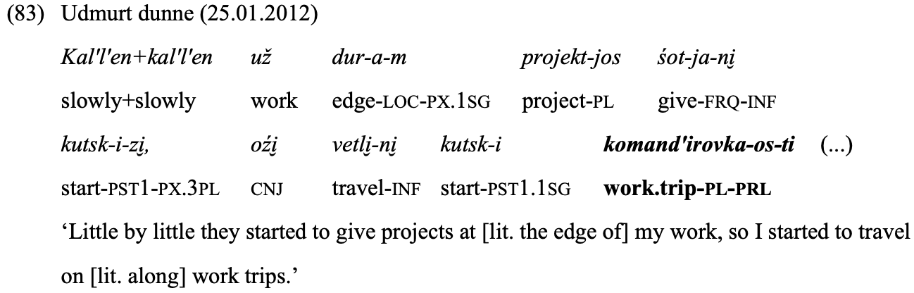
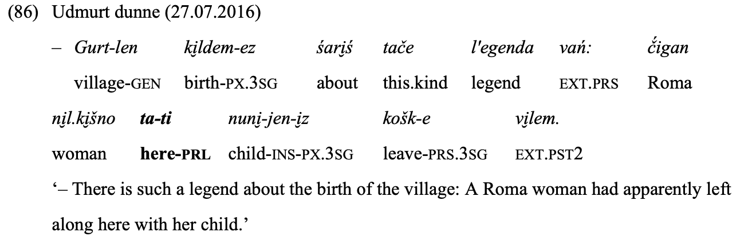
Is the meaning of starting and source given by the verb, not the case in these exx. (pp. 154, 156)?
‘Path Source’
‘Path Source’

Slide 22
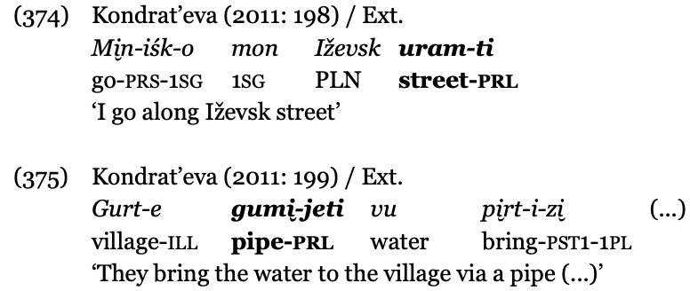
Does encyclopedic knowledge play a role in case semantics (p. 381)?

Slide 23
Terms for the meanings of the cases overlap
For example, for prolative we have: Path, Location (path), and Place (path)
Are the differences really crisp or are they more gradual?
cf. p. 174 “Example (116) elaborates the schema of PLACE completely, but these kind of examples can be considered bridging contexts between PATH and PLACE.” [this suggests gradual transitions among the meanings]
Section 7.1.2 seems to regard overlaps in the semantic structure of spatial cases as a problem, but shouldn’t overlaps be expected in language? Isn’t it often the case that languages allow for multiple ways to encode the “same” realia?
We already saw examples of meanings of elative that are classed differently but seem very similar; more exx. on next 4 pages…

Slide 24
Prolative (going to a number of places)
pp. 148-149 (74) avto.salon-jos-ti [car.dealership-PL-PRL] Path(Middle)
p. 154 (83) komand'irovka-os-ti [work.trip-PL-PRL] Path(source)
p. 162 (95) koncert-jos-ti [concert-PL-PRL] Location(Path)

Slide 25
Egressive (from a street)
p. 249 (206) Kirov ul'č́a-i̮ śen [PLN street-EGR] Place
p. 258 (217) Babuškin ul'č́a-i̮ śen [PLN street-EGR] Mental process

Slide 26
Illative (to work)
p. 278 (241) už-e [work-ILL] Goal
p. 283 (250) už-e [work-ILL] Goal (Endpoint)

Slide 27
Approximative (here and there)
p. 367 (360) so-lań+ta-lań [there-APR+here-APR] Direction and Place
p. 371 (365) so-lań+ta-lań [there-APR+here-APR] Location
p. 374 (369) so-lań+ta-lań [there-APR+here-APR] Place

Slide 28
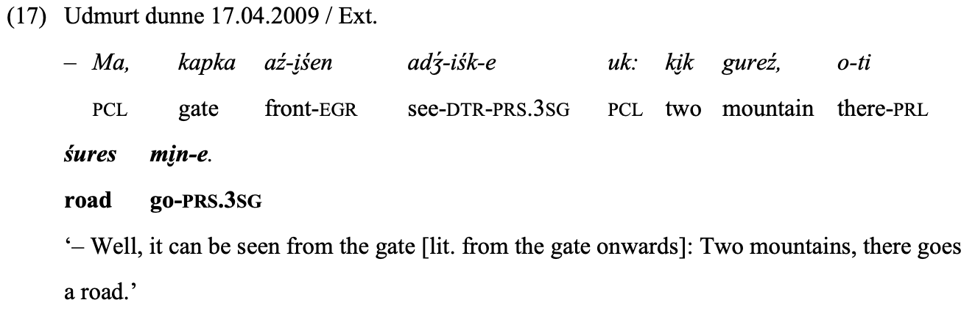
Fictive motion: is this relevant for more exx.?
Several exx. are identified in introductory chapters as fictive motion, for example (17), p. 44:
But otherwise fictive motion does not figure in the dissertation much. Maybe more could be done with this concept?

Slide 29
Other possible exx. of fictive motion?
p. 171 (111) šur-ti vi̮ ž-ez [river-PRL bridge-ACC] ‘bridge over river’
p. 250 (206) Kirov ul'č́a-i̮ śen [PLN street-EGR] ‘Pushkin street is closed from Kirov street’
p. 253 (211) 5-i̮ śen [five-EGR] ‘(the number increased) from 5 to 7’
p. 254 (212) 21 nunal-i̮ śen [21 day-EGR] ‘lasts from 21 to 90-100 days’
p. 262 (222) Trassa-i̮ śen [highway-EGR] ‘the road from the highway to Izgurt’
p. 233 (223) Č́imošur-i̮ śen [PLN-EGR] ‘the mountain stretches from Čimošur to Spring Hill’
p. 300 (277) škola-je [school-ILL] ‘roads leading to the school’

Slide 30
pp. 60, 61
“If children learn to connect linguistic elements to categories, the categories must be non-linguistic.”
“…there is a structured conception of space and spatial configurations in human cognition, and this structure is systematically mapped onto language. These presuppositions also underlie this study. The basic human conception of space and spatial configurations is not dependent on language, but rather is prelinguistic”
Are these necessary assumptions? Couldn’t it be possible for linguistic and non-linguistic categories to co-evolve? Even if human perception is universal, could conception be different? And is it possible to distinctly untangle perception and conception?

Slide 31
Concluding questions about this line of research

Slide 32
Imagine you are a teacher…
If you were teaching someone the Udmurt spatial cases, how would you do it?

Slide 33
Imagine a perfect world with unlimited resources and no wars…
If you had unlimited resources to continue this line of research, what would you do? What kind of research would you do if you could go to Russia/Udmurtia?

Slide 34
What has changed?
How have your ideas changed over the course of your research?
What would you have done differently?

Slide 35
Circling back to the main point…
What does this research tell us about language in general (not just Udmurt)?

Slide 36
Assessment of merits and critical points

Slide 37
Assessment of merits
appropriate choice of theoretical framework, well-structured analysis
solid and deep control of theoretical framework, consistently applied and made very accessible to a wide range of linguists
first ever to provide quantitative data on the distribution of senses within Udmurt spatial cases, and first to approach this topic following traditions of Cognitive Linguistics
adaptation of theoretical models previously focused mainly on English to facts of Udmurt
documentation of facts of Udmurt
quantitative data on the distribution of senses within Udmurt spatial cases
illustrated with 380 authentic examples, all supplied with Leipzig glossing and translations

Slide 38
Critical points
There could be more focus on places where the case semantics overlap, where the cases compete with each other, and on the relationship between the case meanings and the meanings of the words they mark and their collocates.
We have learned about the relative frequency of senses within the Udmurt spatial cases, but what abоut their overall relative frequency and what does this tell us about source vs. goal expressions in Udmurt?
Data has been archived on Zenodo, but it is not certain that this conforms to the FAIR principles of research (findability, accessibility, interoperability, and reusability). Riku Erkkilä might consider a professionally curated repository such as TROLLing (https://site.uit.no/trolling/).

Slide 39
Proposal concerning acceptance of dissertation
I hereby propose that the PhD dissertation The semantics of Udmurt spatial cases, presented and defended by Riku Erkkilä today, April 25, 2026, be accepted by the Faculty of Humanities of the University of Helsinki and Ludwig-Maximilians-Universität München.
CONGRATULATIONS
to Riku Erkkilä, his mentors, family, and friends!

